Slide 1
Big Mountain Ticket Prices
Prem panchal

Slide 2
Current Ticket Prices
Currently at $81 per adult weekend ticket
Current price was created comparative to other resorts
Does not look to leverage uniqueness of the Resort
How to Improve Revenue?

Slide 3
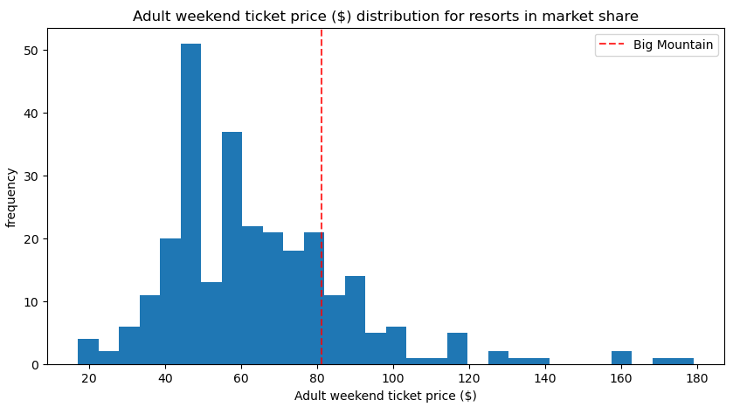
Update Ticket prices to $95 per ticket
+/- $9 to account for variance
About average in relation to other resorts across the country but upper end of Montana resorts
Major selling points of all Resorts
Snow Making equipment
Total Chairs
Total Runs
Total Skiiable Terrain

Slide 4
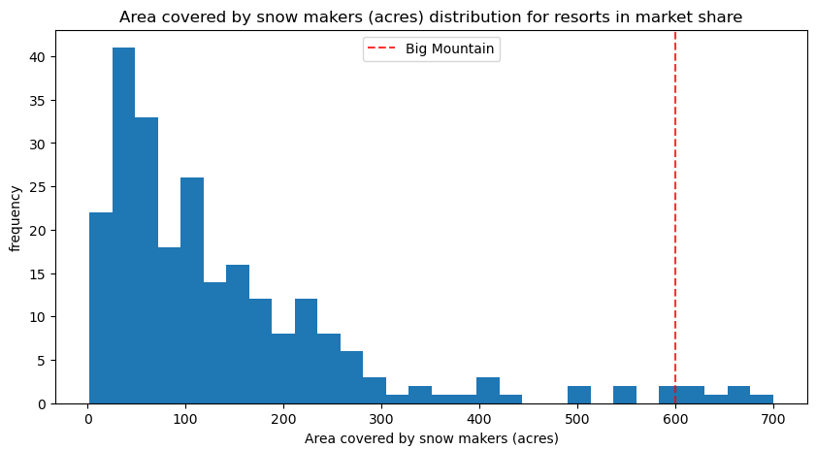
Snow Making Area
Guaranteed snow is likely very important for customers

Slide 5
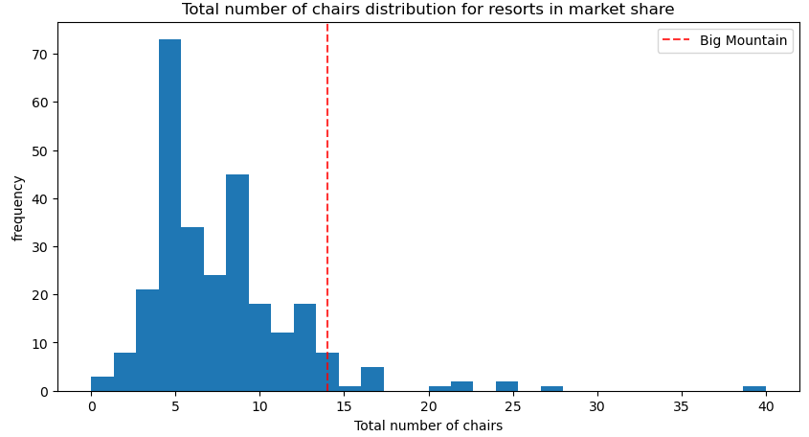
Total Chairs
Easy Transportation within the resort

Slide 6
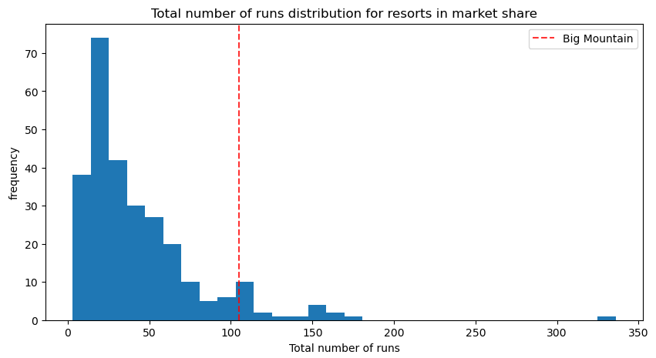
Total Runs
Run Variety important for repeated customers

Slide 7
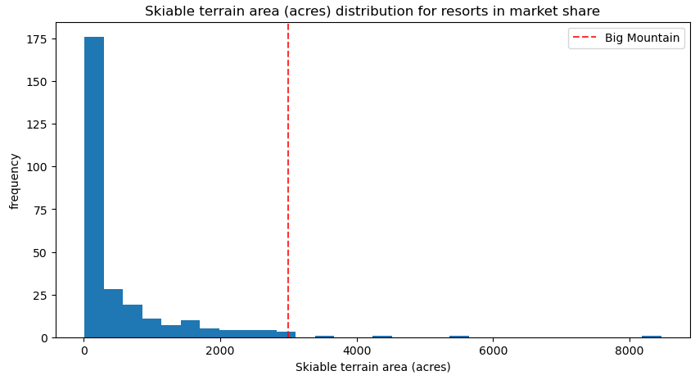
Total Skiiable Area

Slide 8
Conclusion
Big Mountain facilities and Amenities are top notch in comparison to other resorts in the market share
Raise ticket prices to a minimum of $84/ticket, while being able to reasonable go up to $95

